Slide 1
Lecture 11b Introduction to Algorithm Design

Slide 2
Recall: Problems
Let X be a set with elements called problem inputs or instances, and Y a set of outputs. Stating it simply:
A decision problem is a subset of X, D⊆X (equivalently, a function D: X→{0,1}).
A function problem is a function f: X→Y.
A search problem is a relation S: X→Y (i.e., a function S: X→Pow(Y)).
An optimization problem is a search problem, with an additional real-valued function eval: S→R added.

Slide 3
Recall: Problems
All problems
Solvable problems
Tractable (easy) problems
Polynomial or better efficiency - polynomial-time problems
Intractable (hard) problems
Exponential or worst efficiency – non-polynomial time problems
Unsolvable problems

Slide 4
Typical Growth Rates (Most Common Efficiency Functions)
Hard problems
Easy problems
4

Slide 5
Recall: Basic asymptotic efficiency classes
1 | constant
log n | logarithmic
n | linear
n log n | n-log-n
n² | quadratic
n³ | cubic
2^{n} | exponential
n! | factorial
linearithmic

Slide 6
All problems
Solvable problems
Tractable (easy) problems
Unsolvable problems
Intractable (hard) problems

Slide 7
Tractable vs. Intractable problems
A polynomial time algorithm is one whose efficiency is O(n^{c}) for some positive constant c
Even if the efficiency is better, algorithm is also O(n^{c})
Any algorithm whose time complexity cannot be so bounded is called an exponential time algorithm.

Slide 8
Complexity Class P
P is the class of problems for which a polynomial-time algorithm exists.
A problem is outside P if no algorithm exists that solves it in polynomial time.
A problem being in P means it is tractable

Slide 9
All problems
Solvable problems
Tractable (easy) problems =
problems in P
Unsolvable problems
Intractable (hard) problems

Slide 10
Tractable vs. Intractable problems
We will discuss why the division tractable / intractable has been chosen like this
Which algorithms are considered ‘efficient enough’ and which ‘too inefficient’
This definition of "intractable" provides a theoretical framework of considerable generality and power.

Slide 11
Tractable vs. Intractable problems
The significance of this distinction - considerations of:
Behavior for large problem instances
Effect of possible future improvements (even more revealing)
The intractability of a problem turns out to be essentially independent of the particular encoding scheme
The intractability of a problem turns out to be essentially independent of the computation model used for determining time complexity.
The intractability of a problem turns out to be essentially independent of the data structures used

Slide 12
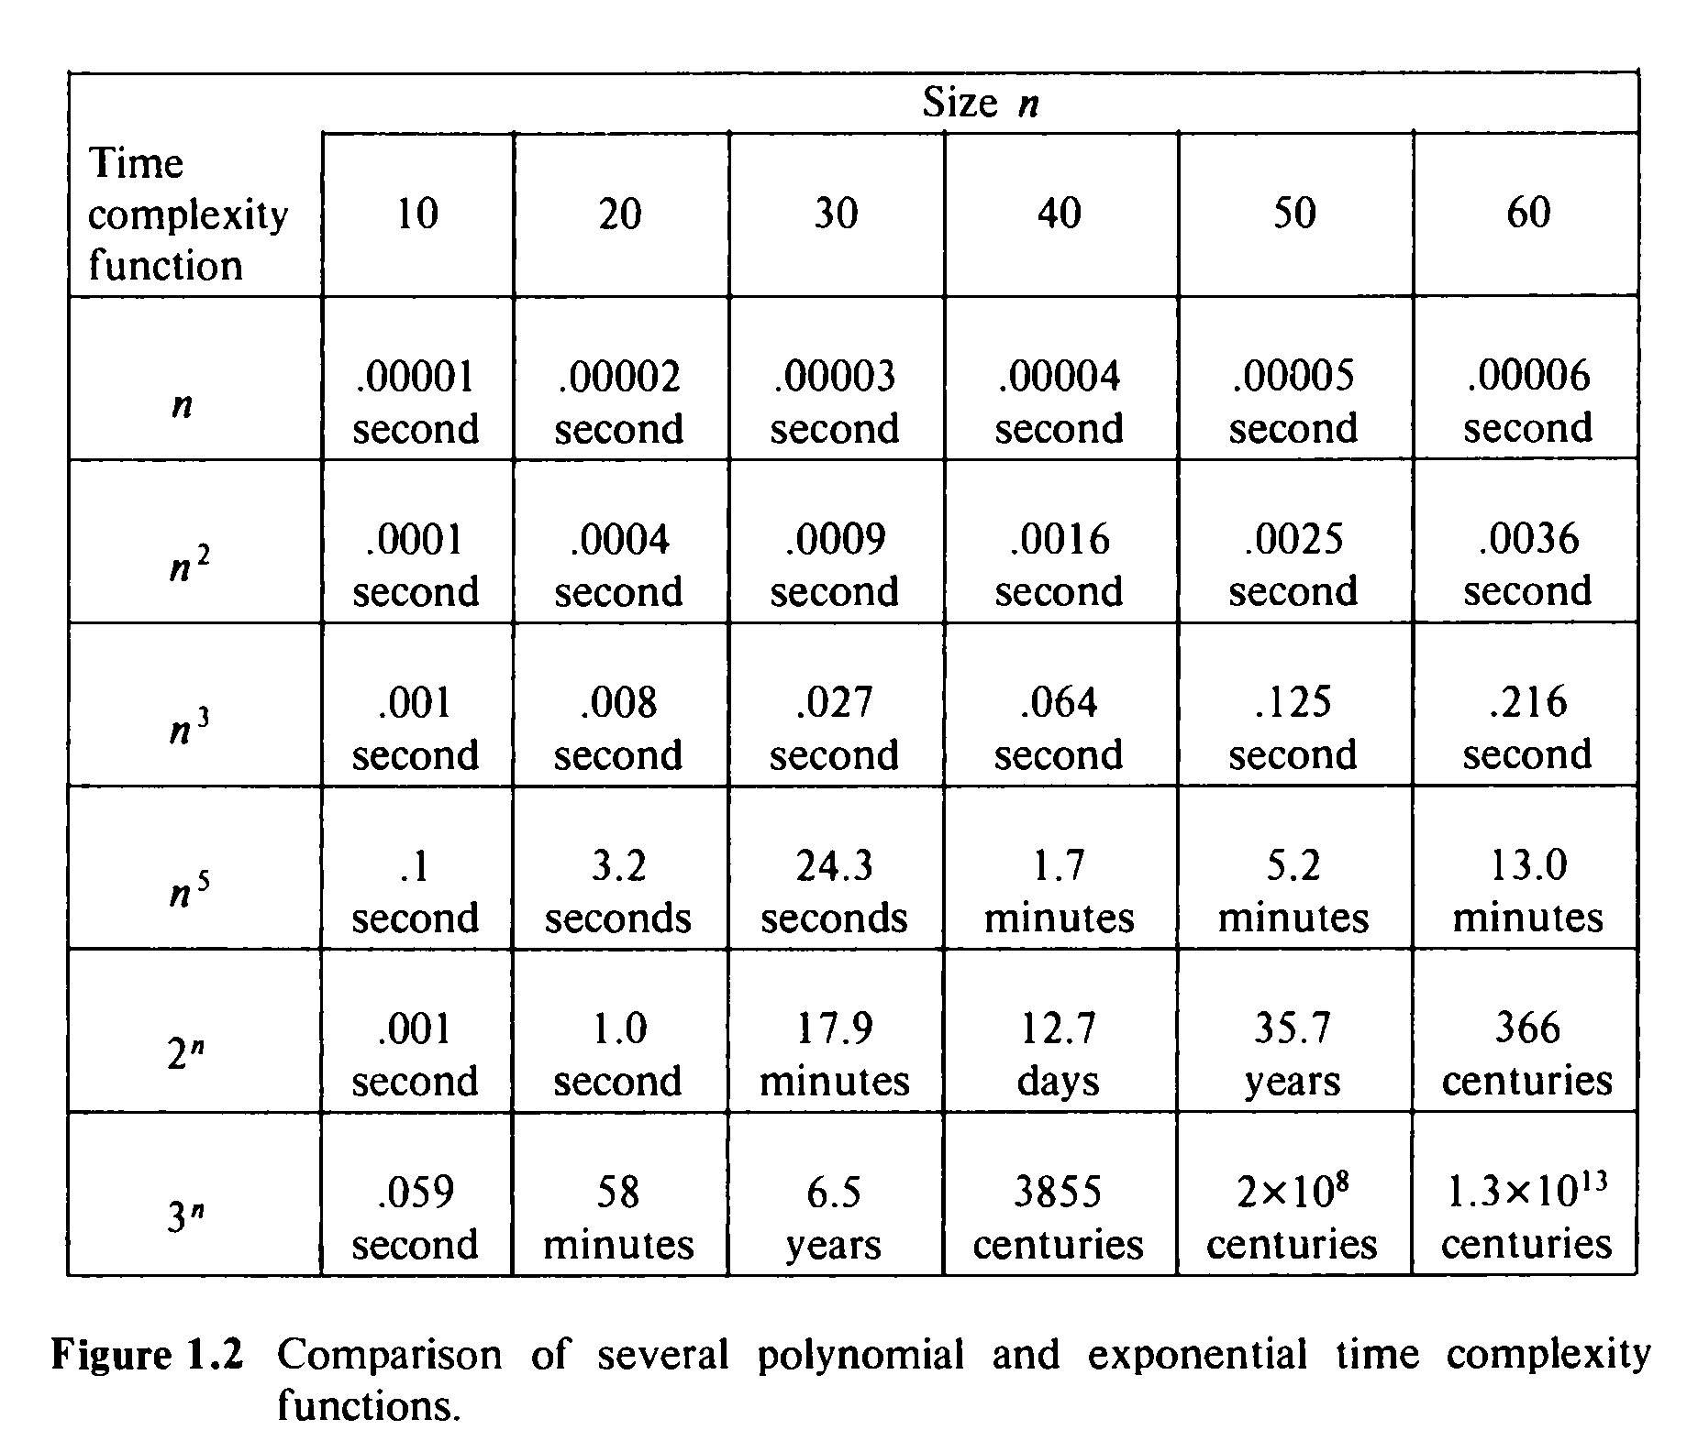
sec,
min
days, years,
centuries

Slide 13
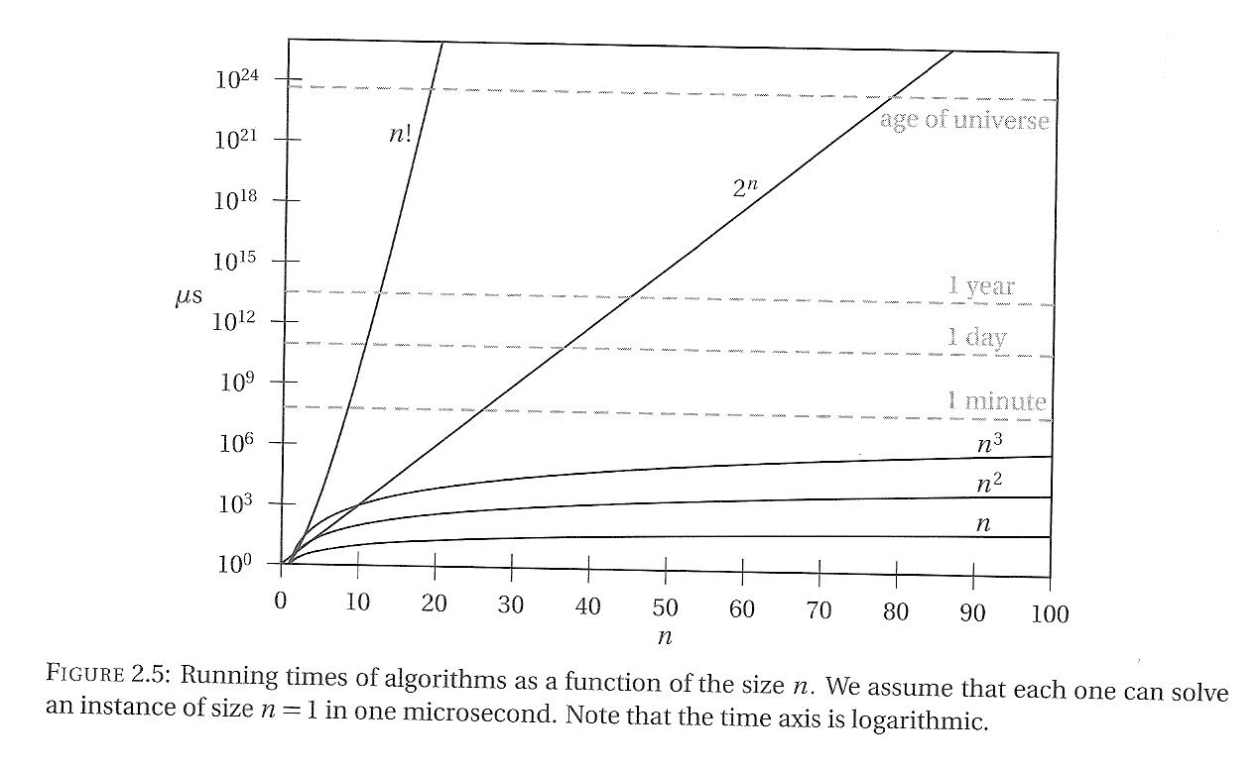

Slide 14
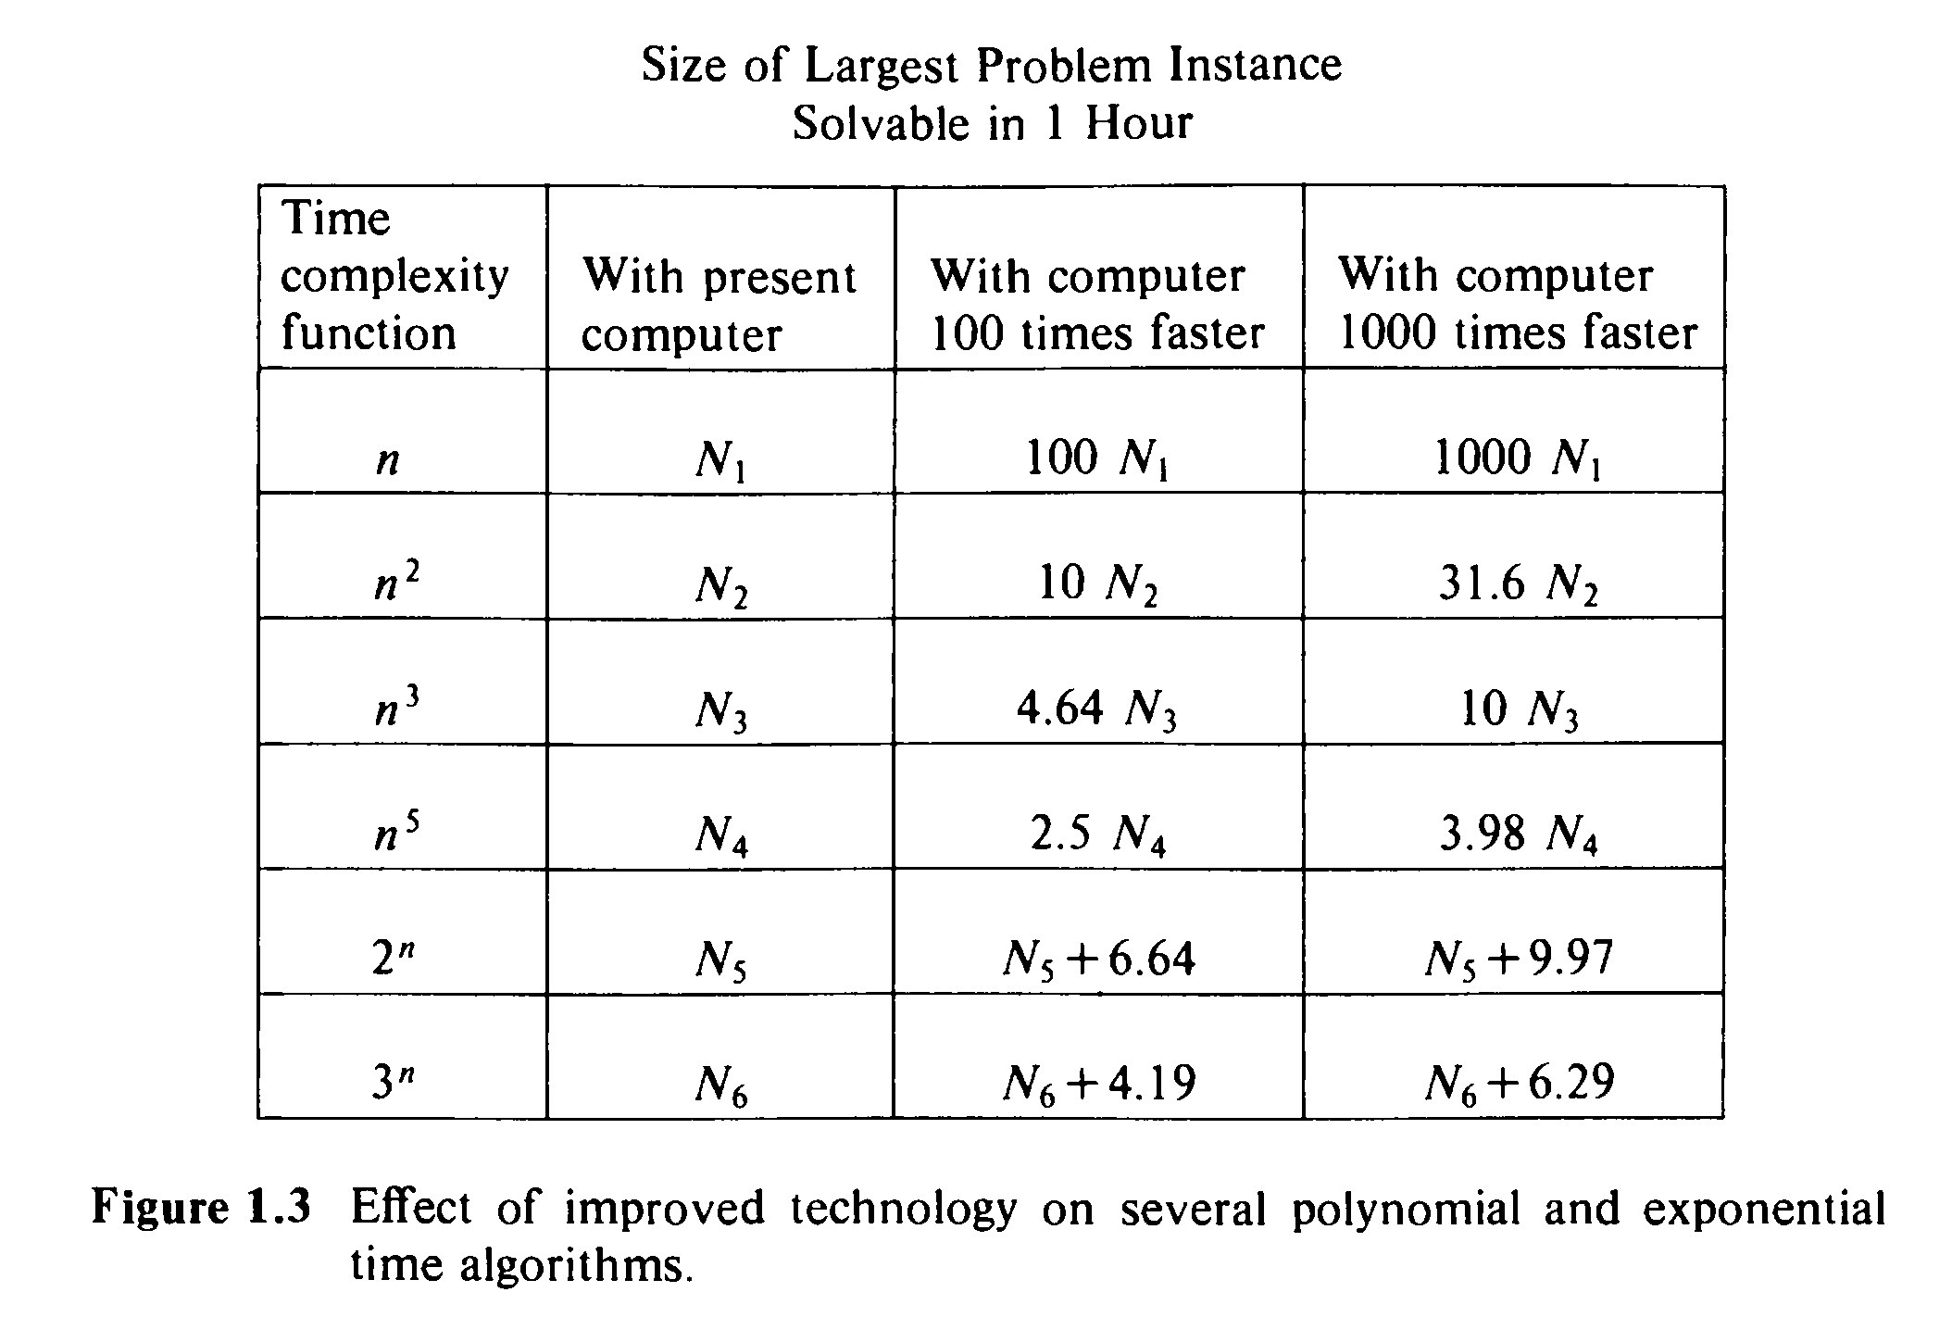
Not essential improvement

Slide 15
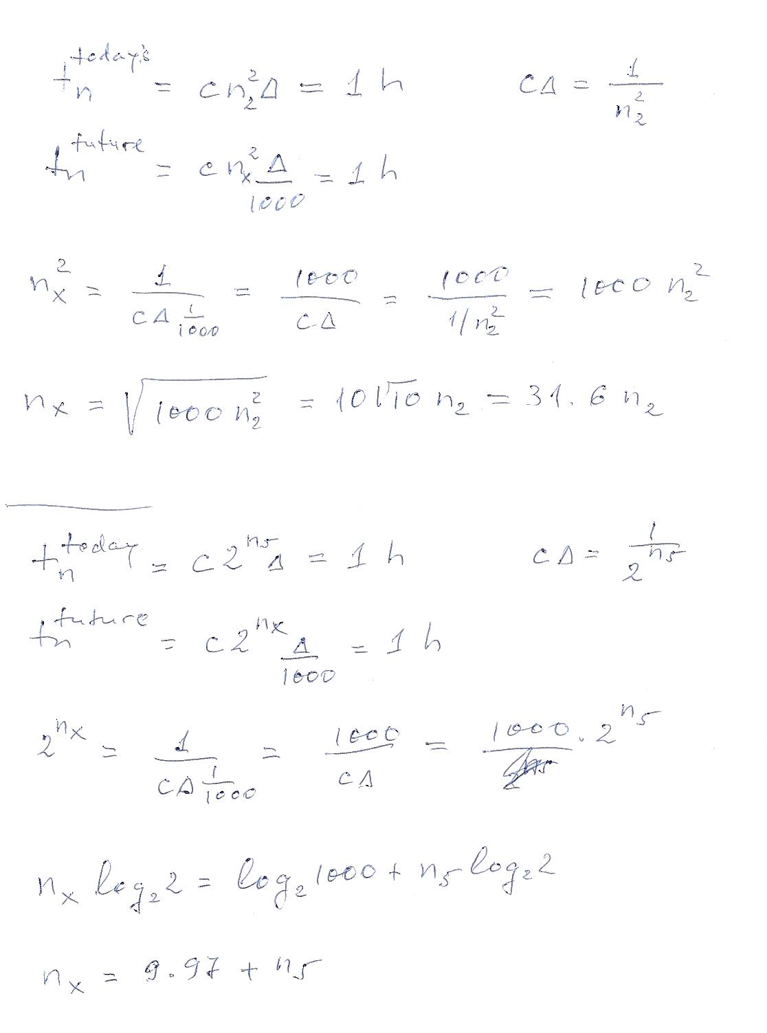
Recall from midterm

Slide 16
Recall from midterm

Slide 17
Recall: Tractable vs. Intractable problems
The significance of this distinction - considerations of:
Behavior for large problem instances
Effect of possible future improvements (even more revealing)
The intractability of a problem turns out to be essentially independent of the particular encoding scheme
The intractability of a problem turns out to be essentially independent of the computation model used for determining time complexity.
The intractability of a problem turns out to be essentially independent of the data structures used

Slide 18
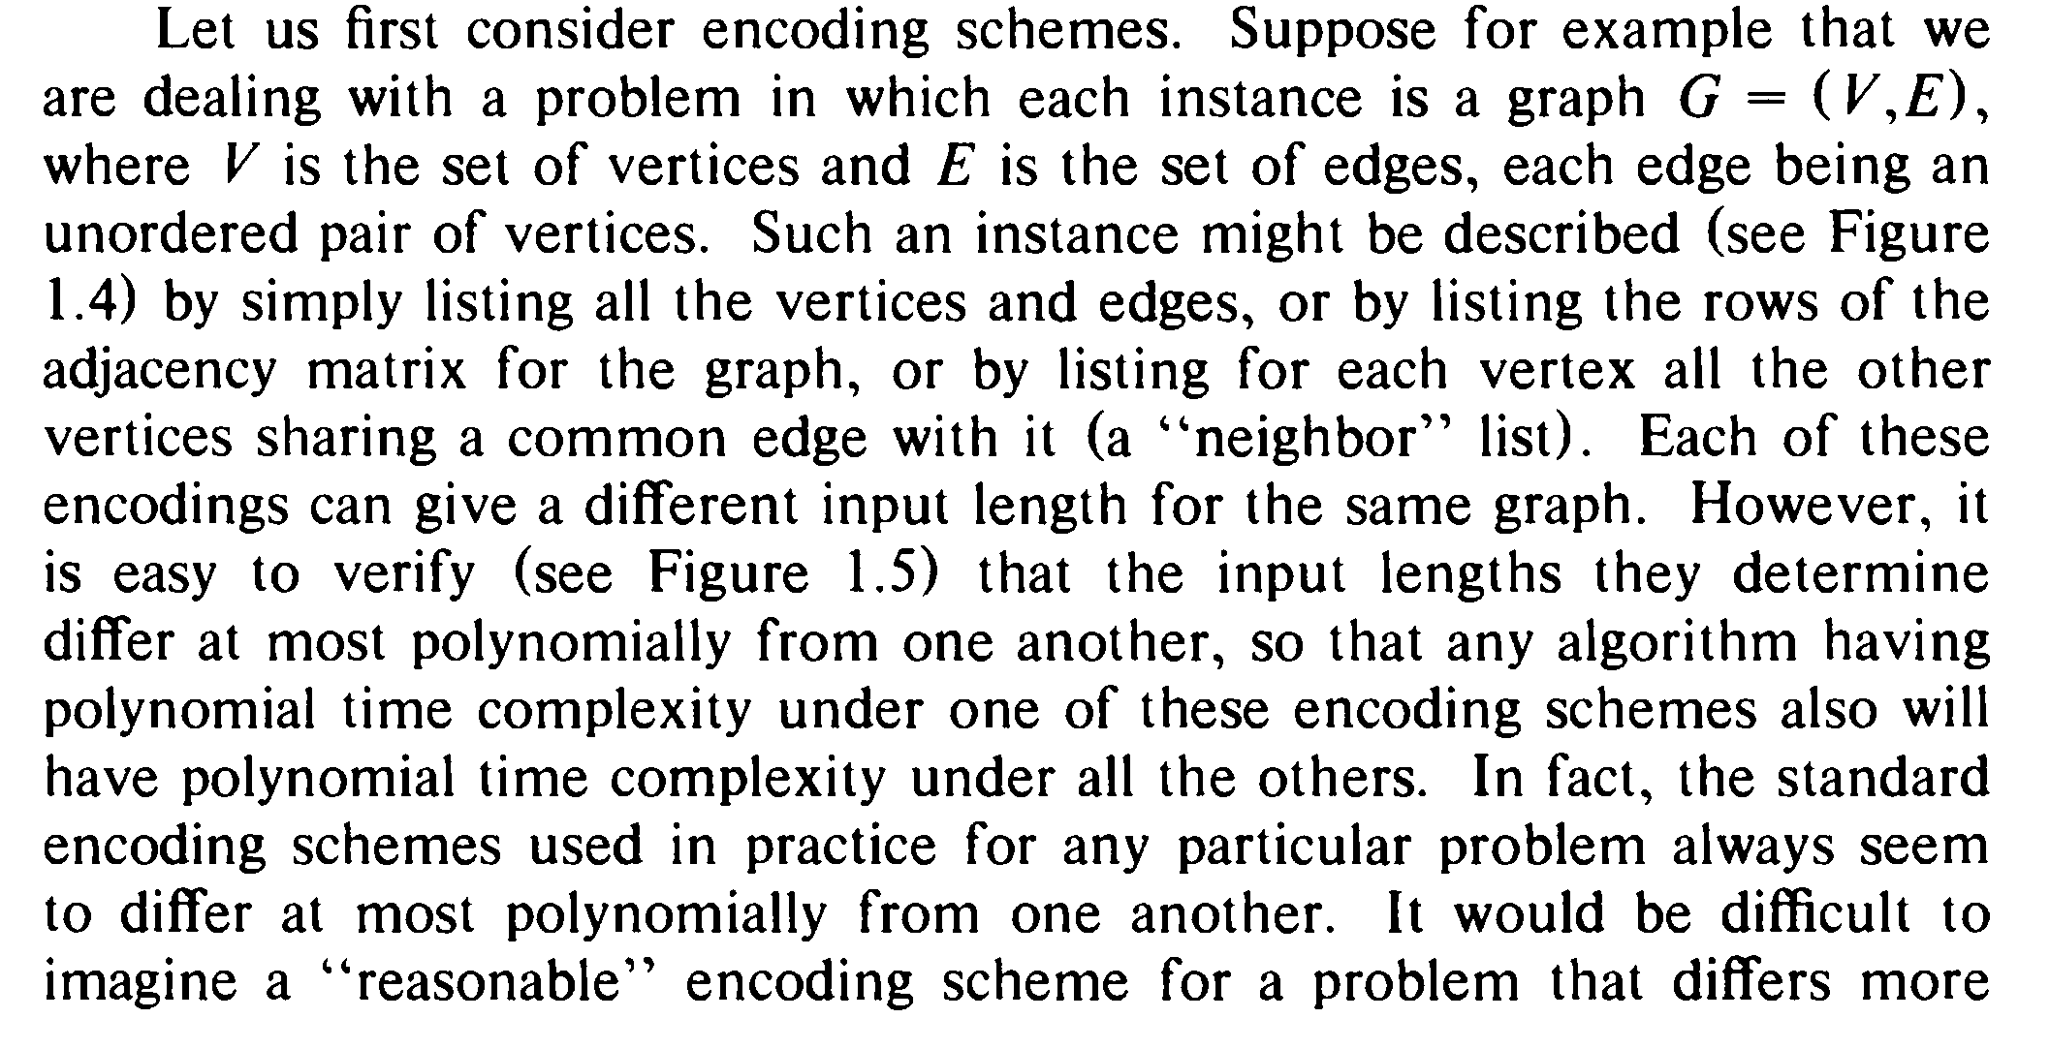
Tractable vs. Intractable problems

Slide 19
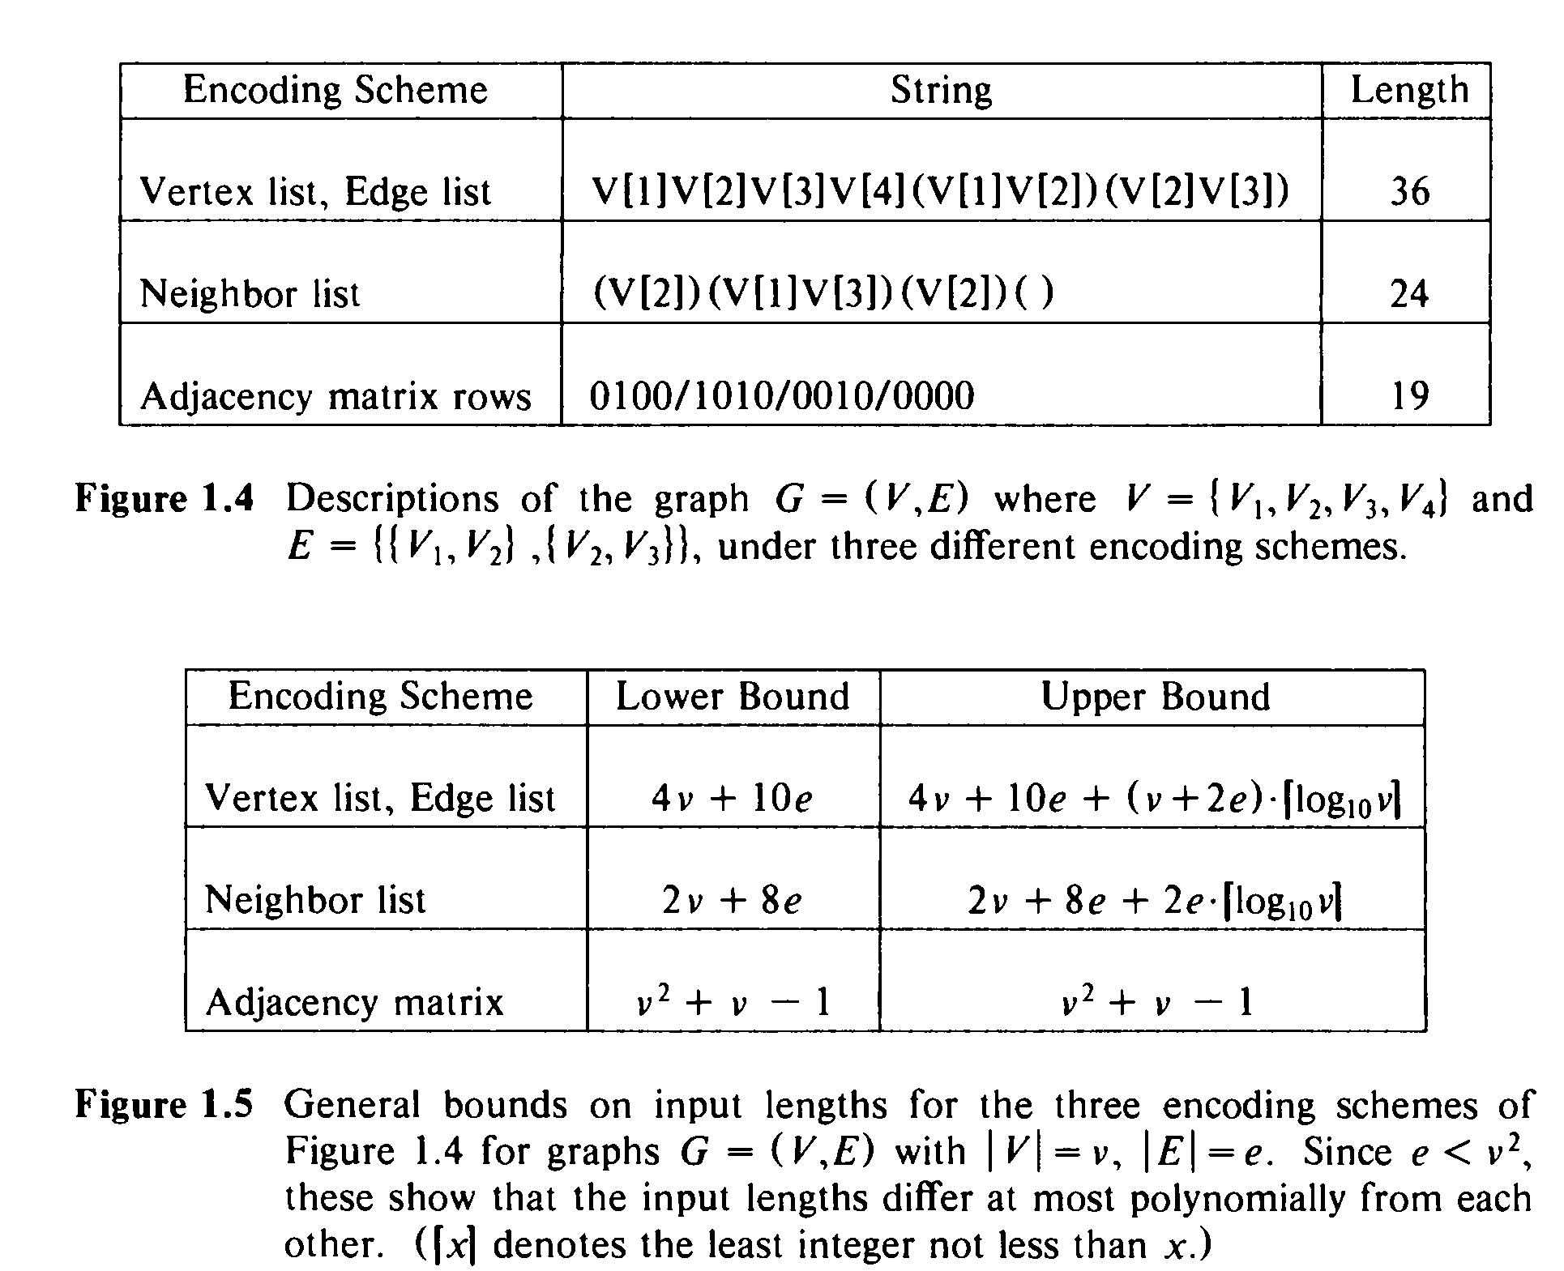

Slide 20
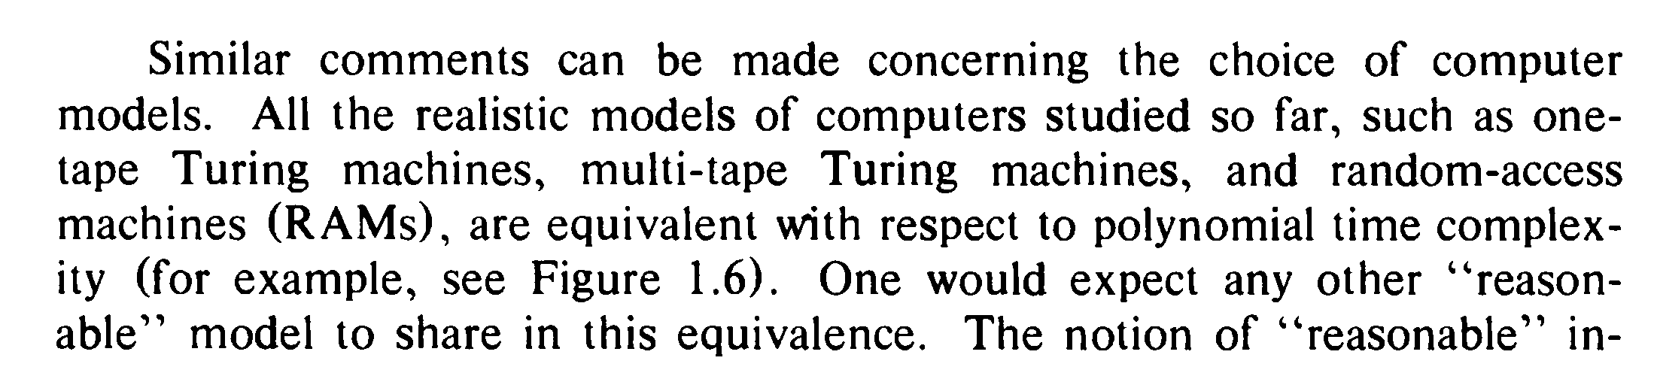

Tractable vs. Intractable problems
Similarly if we consider Turing machine, or RAM machine, or contemporary computer, or massively parallel computer (with at most a polynomial number of processors) – the difference is only polynomial, from polynomial of a given degree we only move to a polynomial of another degree.
The only type of computer that can drastically change the complexity – quantum computers.
More detail: Garey Sec. 1.3, Moore Sec. 2.4

Slide 21
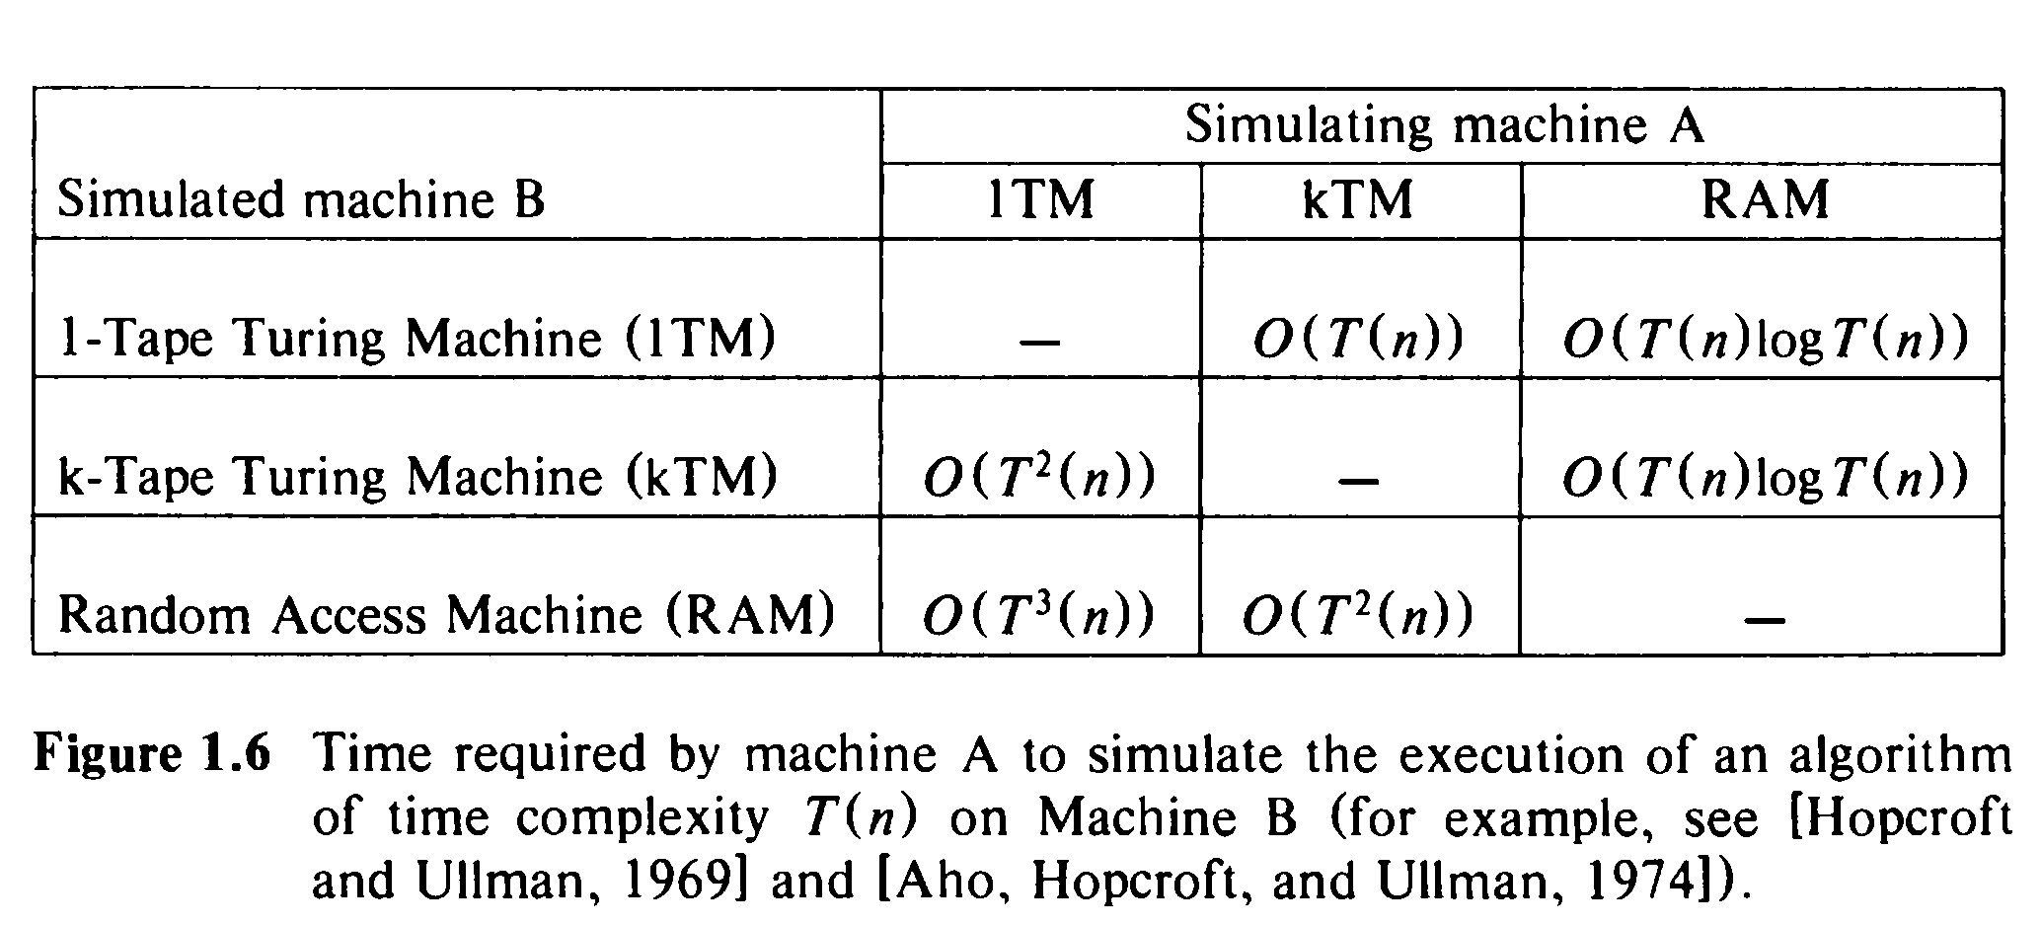

Slide 22
Recall: Tractable vs. Intractable problems
The significance of this distinction - considerations of:
Behavior for large problem instances
Effect of possible future improvements (even more revealing)
The intractability of a problem turns out to be essentially independent of the particular encoding scheme
The intractability of a problem turns out to be essentially independent of the computation model used for determining time complexity.
The intractability of a problem turns out to be essentially independent of the data structures used

Slide 23
Tractable vs. Intractable problems
These considerations indicate some of the reasons why polynomial time algorithms are generally regarded as being much more desirable than exponential time algorithms.
This view, and the distinction between the two types of algorithms, is central to our notion of inherent intractability and to the theory of NP-completeness.
Being in P is a fundamental property of a problem rather than a property of how we deal with it .
The definition is very robust – details don’t matter

Slide 24
We’ll study main complexity classes – P, NP, etc.
Algorithm Design studies techniques for solving problems
In this course we skip this area
Of special interest – how to deal with hard problems
We’ll discuss some of the approaches

Slide 25
Dealing with hard problems

Slide 26
Dealing with Hard Problems
In order to deal practically with hard computational problems, one must often accept weakening of the requirement to guarantee computing the correct result. This can be done in different ways:
Accept a “reasonable” solution which is not exactly correct or, for optimization problems, is slightly suboptimal. The result of this approach is the so called approximate algorithms.
Accept that the probability for finding a correct, or optimal solution may be slightly less than 1 – randomized algorithms.

Slide 27
Dealing with Hard Problems
This leads us to two independent divisions of algorithms:
Exact (precise) algorithms vs. approximate algorithms
Deterministic algorithms vs. randomized (stochastic) algorithms

Slide 28
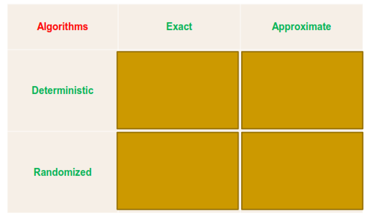
Classification of Algorithms (especially when dealing with hard problems)

Slide 29
Approximate Algorithms
An approximate algorithm does not technically solve the problem, but produces a “reasonable”, “good enough” solution to the problem instance.
One uses approximate algorithms when:
either no exact algorithm for solving a given problem is known, or
known precise algorithms exist but are intractable or computationally too expensive and an approximate algorithm is much more efficient.

Slide 30
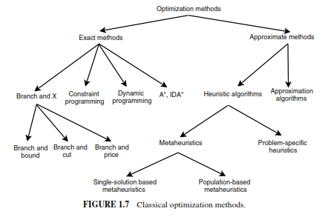
Deterministic algorithms for solving hard problems
Approximate
Exact heuristic
algorithms
Modified from: Talbi – Metaheuristics

Slide 31
Approximate Algorithms
Approximate algorithms:
Approximation algorithms
This is a special group of algorithms known under this name
There is a guarantee related to the evaluation of the solution achieved by such an algorithm, as a ratio of the optimal solution.
Heuristic algorithms which are approximate
Some heuristic algorithms are exact

Slide 32
Heuristic Algorithms
Below not a definition but rather a description
A heuristic algorithm (or simply a heuristic) is an algorithm which is based on some, usually simple, strategy that is inspired by nature or by informal techniques used by humans. It is based on our experience or experiments; it has not been designed in result of formal theoretical deliberations, has not usually been proven but at the same time often gives reasonably good results.
Simpler forms of this definition could be:
A heuristic is a common-sense rule drawn from experience rather than justified by an underlying theory.
A heuristic is a technique designed to solve a problem that ignores whether the solution can be proven to be correct, but which usually is efficient and produces a good solution.

Slide 33
Recall: Dealing with Hard Problems
This leads us to two independent divisions of algorithms:
Exact (precise) algorithms vs. approximate algorithms
Deterministic algorithms vs. randomized (stochastic) algorithms

Slide 34
Randomized Algorithms
In a randomized algorithm there are steps in the algorithm where random choice of two transitions is possible (the probability for each choice is ½). For different executions of the algorithm possibly different choices will be randomly made.
A randomized algorithm that always (independently of the random choices) produces the correct output and only the complexity of the algorithm can be considered a random variable, is called a Las Vegas algorithm. (That means that a Las Vegas algorithm is actually an exact, but not deterministic algorithm.)
In general, however, the output for a given input may be considered as a random variable – such randomized algorithms are called Monte Carlo algorithms.
But we can make the probability of calculating a wrong result as small as we want

Slide 35
Other Classifications of Search
Systematic search
The search graph is explored in a systematic manner. Usually (unless some sort of infinite looping is possible) this guarantees that eventually either a solution will be found or, if no solution exists, that fact will be determined with certainty – this property is referred to as completeness.
Alternatives that have been explored already, and the ones that have been found but not explored yet, are stored in global data structures (VISITED and FRONT).
Local search
The search starts from some location in the search space and moves subsequently from the present location to a neighboring location. When the control is in a specific state, only the possible transitions from the current state are analyzed. A move to a new current state is usually irrevocable. Typically, local search algorithms are incomplete.

Slide 36
Recall search space and neighborhood

Slide 37
Output-solution assumption in search algorithms
Often we consider the problem instance x∈X to be specified (chosen). E.g., the initial node of a graph is given.
Formally, X is a one-element set, X={x}.
In such a case we practically equalize the notions of output y∈Y and feasible solution <x,y>∈S.
Now, a search problem degenerates to simply a set S of feasible solutions called a search space (also solution space, or configuration space, or state space).
The solution space is only a set (not a graph).

Slide 38
Neighborhood
Sometimes, the search space S (which as we remember is simply a set) is equipped with a neighborhood relation (called also successor relation) N: S→S.
Equivalently, one can think of a neighborhood function N: S→Pow(S) which, for each feasible solution s∈S defines a set of neighbors of s, N(s)⊆S.
The neighborhood relation may be based on some kind of similarity/distance between solutions.

Slide 39
Neighborhood
The neighborhood relation is used when solving a search problem using a local search algorithm.
Utilizing the neighborhood relation, we can “upgrade” the search space (a set) into a search graph (called also a neighborhood graph) which is a directed graph with a node set S and an arrow from node s to node s’ iff s’ is a neighbor of s, i.e., s’∈N(s).
Instead of a search graph one may use a search tree.

Slide 40
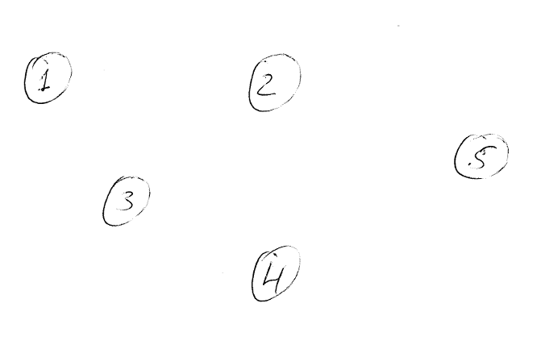
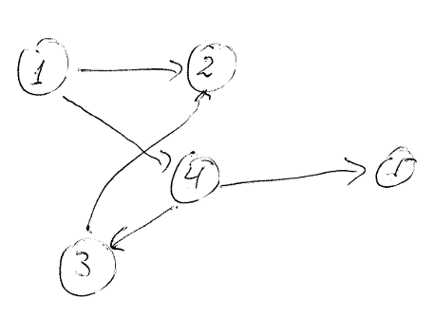
Solution space is a set
Solution space is a graph
N(1) = {2,4}
N(2) = ∅
N(3) = {2}
N(4) = {1,3,5}
N(5) = ∅

Slide 41
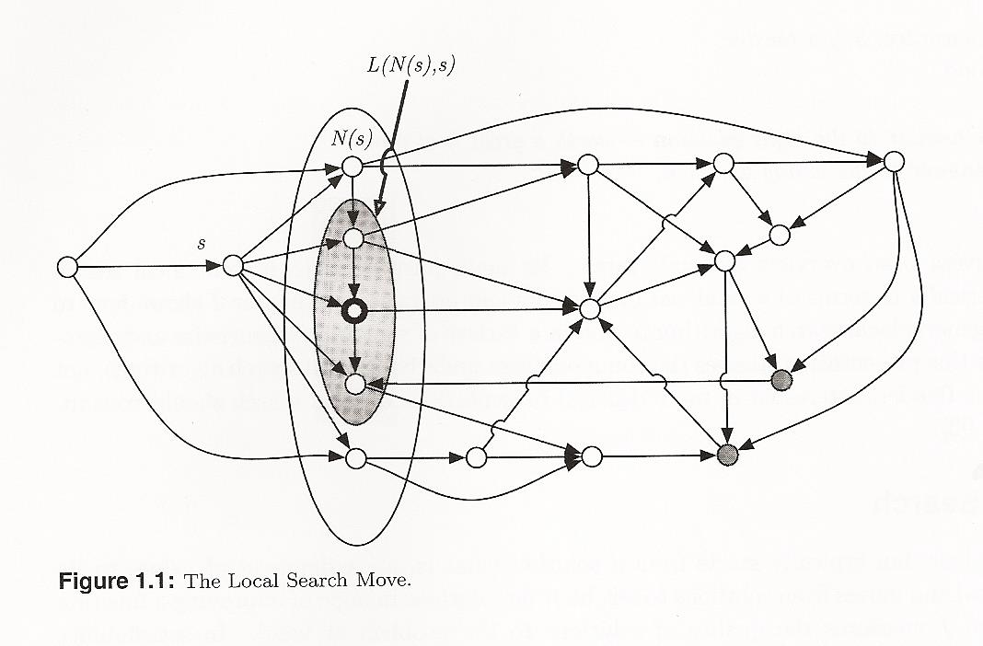
Neighborhood
N – neighborhood
L – legal moves

Slide 42
Other Classifications of Search
Uninformed (exhaustive, blind, naïve) search – no problem-dependent knowledge is used, and generally the whole state space is explored. Classical examples are breadth-first search, depth-first search with leap-frogging, depth-first search with backtracking, iterative deepening, uniform-cost search (arrows have been assigned costs), etc.
Improved uninformed search - some problem-independent strategies for reducing the size of the explored part of the state space are utilized. A typical example is the Branch-and-Bound strategy. (Some authors include here backtracking)
Informed search – problem-dependent knowledge is exploited in order to direct the search and avoid exploring unpromising parts of the state space. This is achieved by introducing a problem-dependent heuristic function. This group includes numerous heuristic algorithms studied in Artificial Intelligence and Combinatorial Optimization.

Slide 43
Two Kinds of Presentation of the State Space
It is useful to note that there are two main kinds of definition of the state space:
In an incremental formulation of the problem through a state space a state represents certain partial solution (i.e., only some of the components of a solution); the search typically starts from an “empty” state and an action (arrow in the search graph) corresponds to augmenting the state description usually adding the value of a new component. A classic example of this approach is the state space for the 8-queen problem where in the initial state no queens are placed, and each transition corresponds to adding a queen in the next empty row.
In contrast, in a complete-state formulation we start with a complete solution (e.g., all 8 queens placed but possibly some pairs of queens attacking each other) and performing changes on the current solution in order to arrive at a final solution (with no attacking pairs, or an optimal solution in optimization problems).

Slide 44
Recall
Deterministic algorithms for solving hard problems
Approximate
Exact heuristic
algorithms
Modified from: Talbi – Metaheuristics

Slide 45
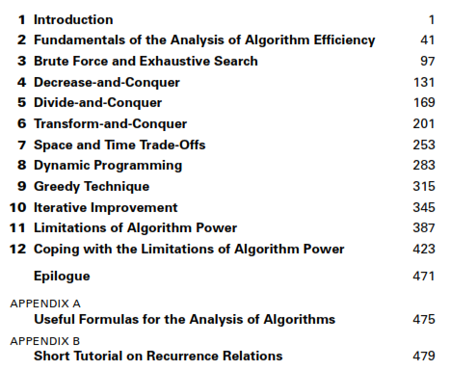
Levitin 3rd ed.
exact
exact
often appr.
heuristic, local search, incremental formulation
often appr.
local search, complete-state formulation
See next page
Mentioned: randomized algorithms, quantum computing, DNA computing

Slide 46
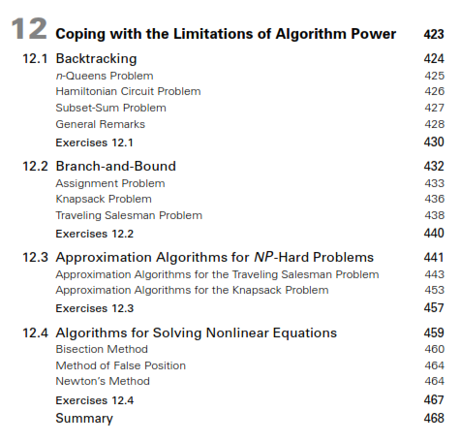
here local search, incremental formulation
improved uninformed search

